Slide 1
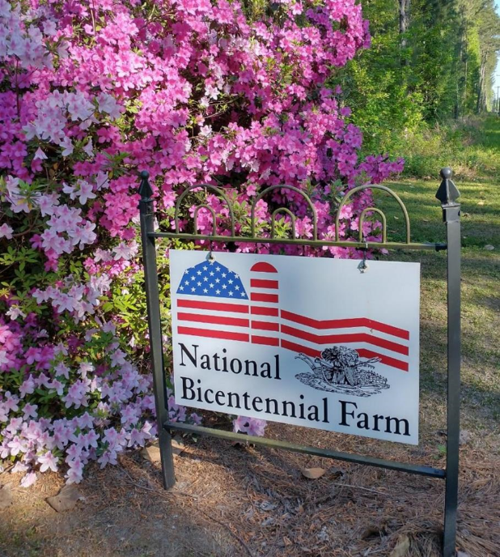


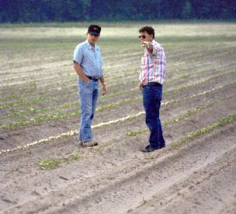
Family Farms, The Endangered Species Act, and The Environment
1772
Woodland, NC
Stanley Culpepper
University of Georgia
Tifton, Georgia
Dr. Alan York

Slide 2
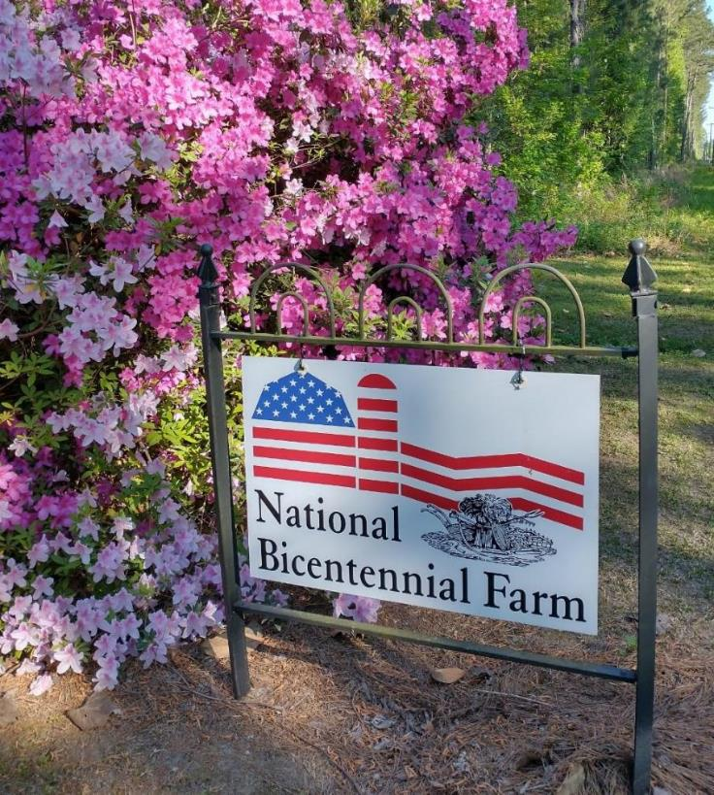
Presentation Objectives
Herbicide strategy adds flexibility
Outreach – education extremely complex but achievable
Species mapping improvements
1772
Notes:
Good even

Slide 3
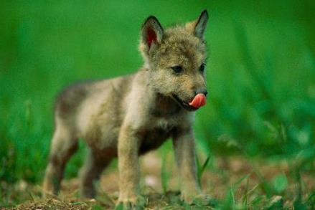

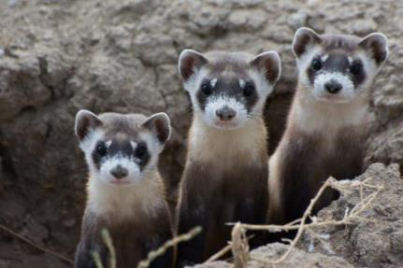
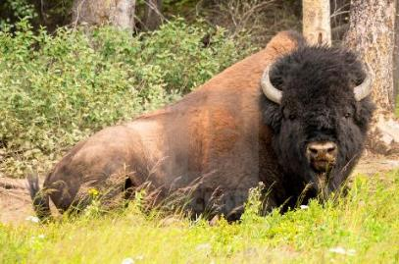
The Endangered Species Act (ESA)
ESA implemented in 1973
Provides framework to conserve & protect endangered & threatened species & their habitats!
Grey Wolf
Whorled Sunflower
Black-footed Ferret
Total of ~1600 species + 900 critical habitats!!!
Wood Bison

Slide 4

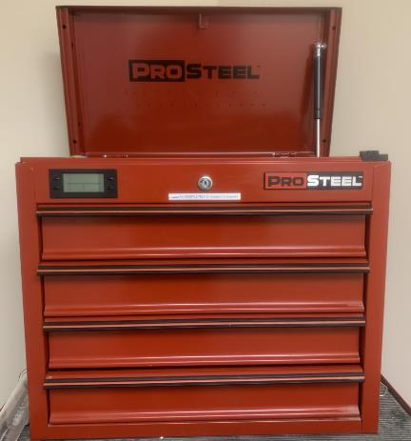
The Farm’s Dilemma with ESA
Pest Management Toolbox
Court removal of tools
Overwhelming regulations

Slide 5
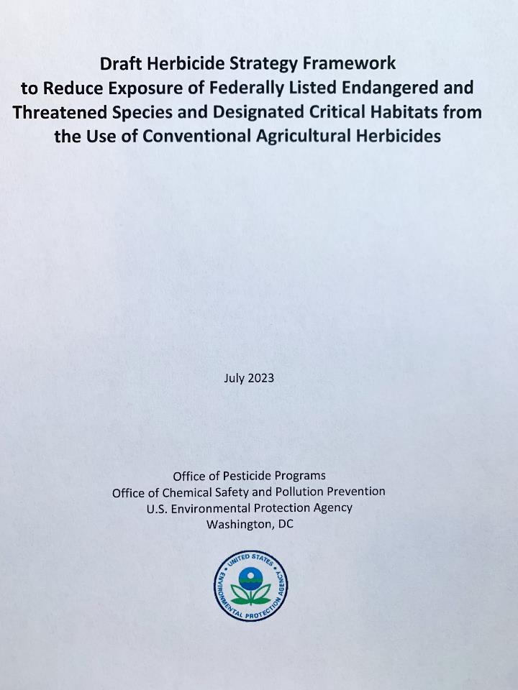

Herbicide Strategy Evolves
Proposed strategy = likely game over for many of us

Slide 6

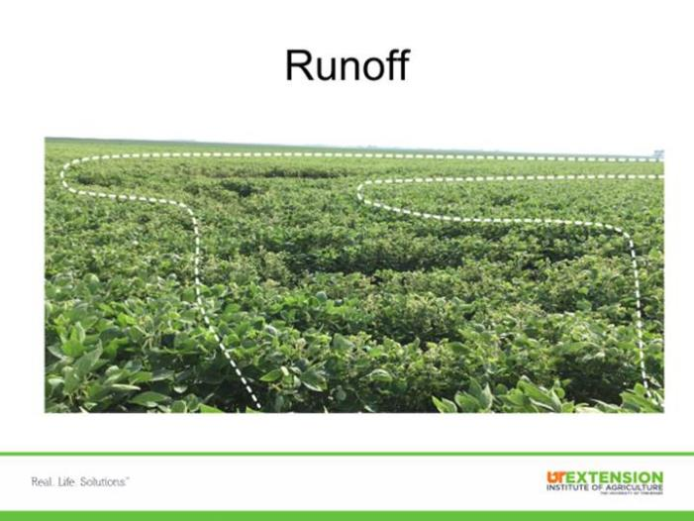
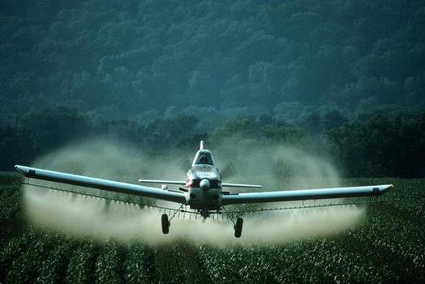
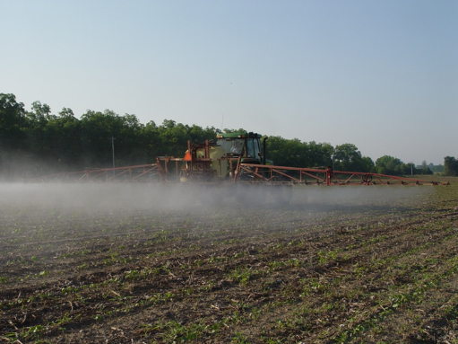
The Ultimate Goal of EPA Scientists to Reach Compliance is Sound; Unfortunately, the Approach has Been Painful
Herbicide Footprint
GOAL: Ensure pesticides are applied on-target and remain there!
Spray Drift

Slide 7
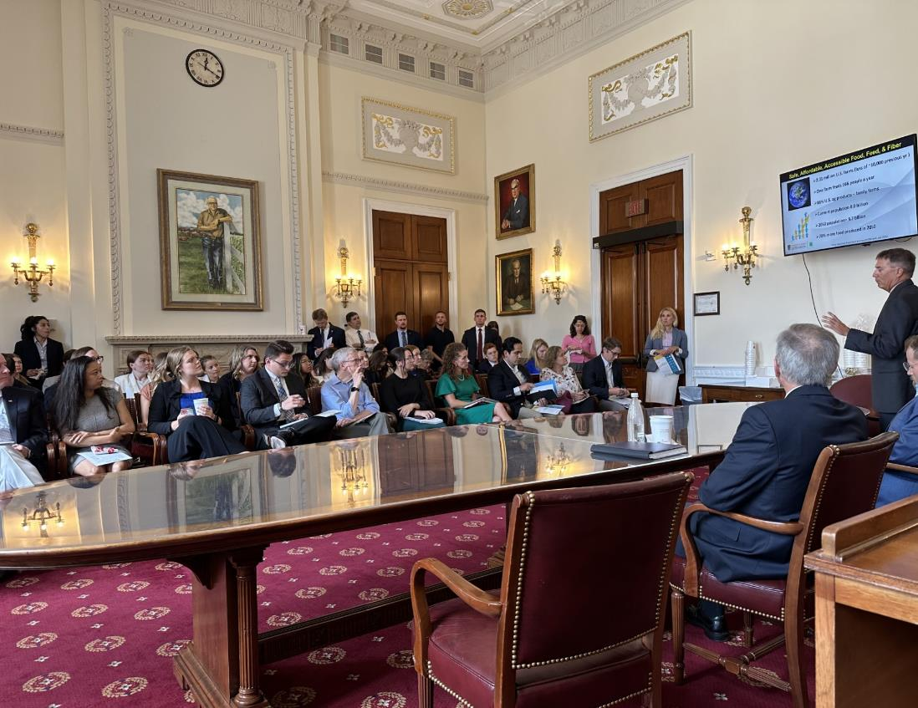

Agricultural Stakeholders Became Very Engaged in Support of Our Family Farms
Pesticide Stewardship and the Endangered Species Act

Slide 8
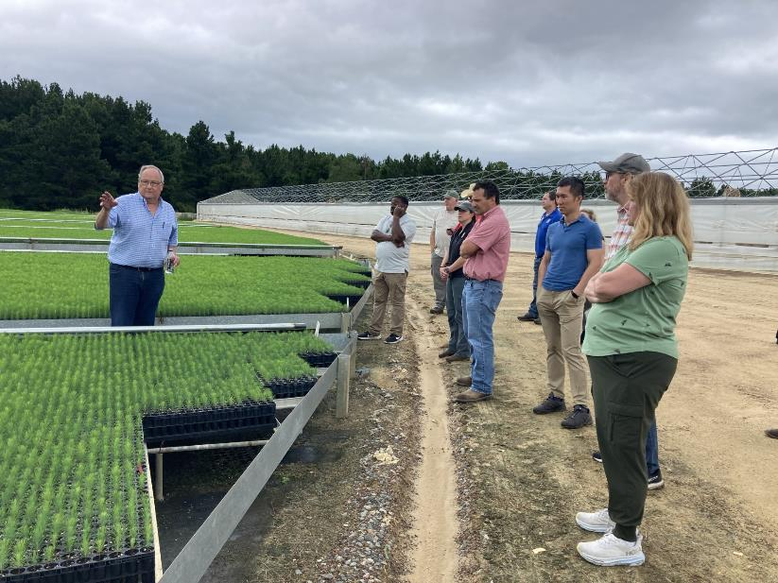
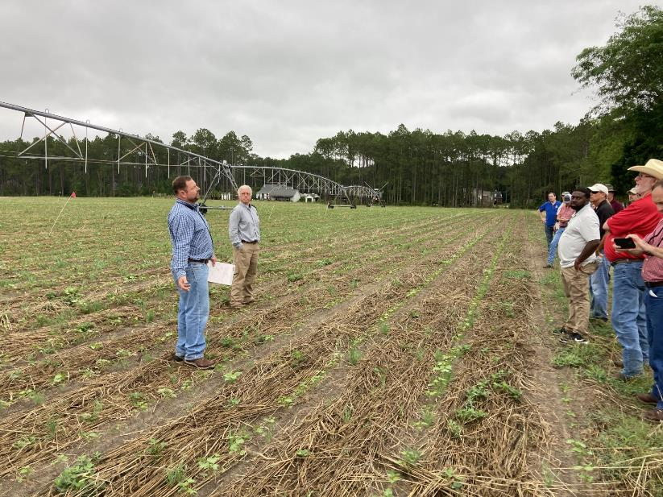




Enormous Effort = Game Changer = Science
Farmers

Slide 9

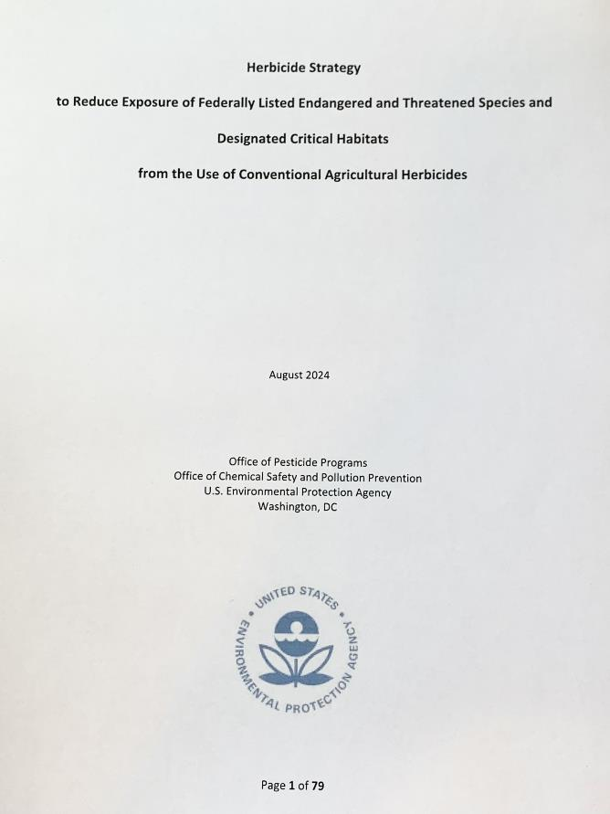
Herbicide Strategy Evolves
Does not impose restrictions - starts as products are registered or reviewed
Proposed strategy = likely game over for many of us
FINAL strategy = still in the game

Slide 10
Herbicide Strategy Evolves
Decision by field (not farm)
Decision by product
Decision by crop
Challenging but provides an opportunity to do our own risk assessment at the field
Flexibility for the farm
Buffers for drift
Runoff mitigations
Complexity

Slide 11
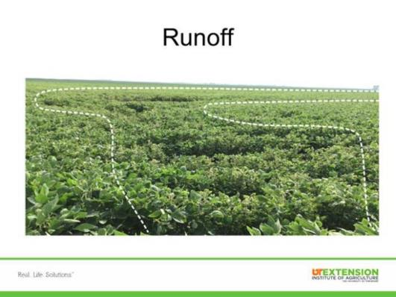
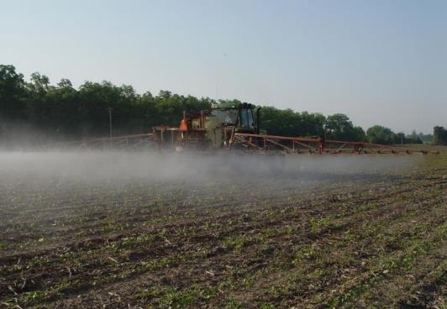
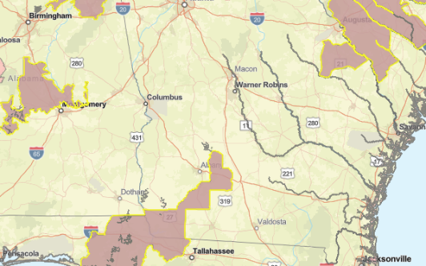
#1
Must Understand To Get Started
1. Runoff: each pesticide will be assigned a value of potential of product to runoff and damage species or habitat (0-9 points).
2. Particle Drift: each pesticide will be given a buffer drift requirement as influenced by application method (ground, airblast, airplane, etc.)
3. BLT: Website identifies if your field is in a pesticide use limitation area (PULA).
#2
Particle drift
#3
Bulletins Live! Two

Slide 12
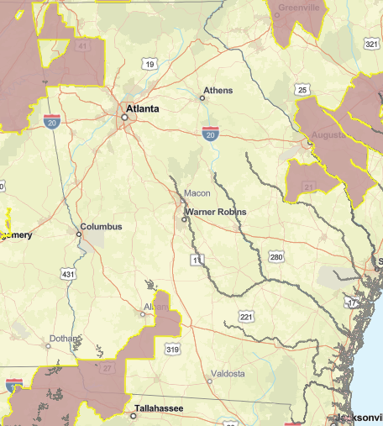

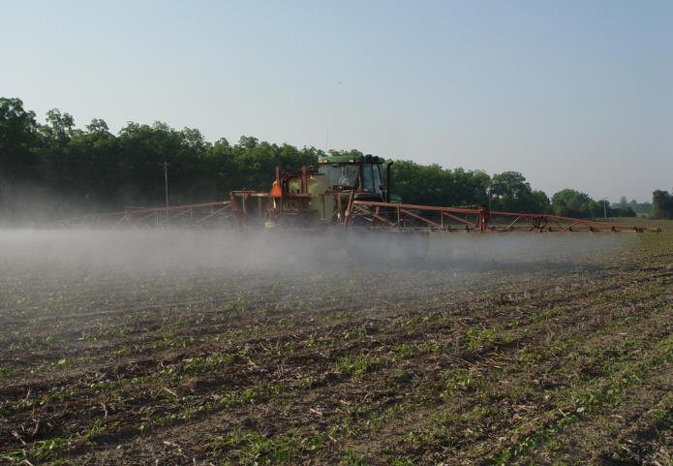
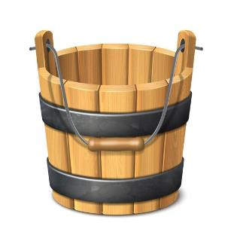
It is Quite Complicated
#3
#1
#2
BLT
Particle drift
0-9 points
0-230 feet
Pesticide Use Limitation Area
*Increase points for runoff
*Increase drift buffers
*Remove tool
Runoff
Drift - ground
each field
each field

Slide 13
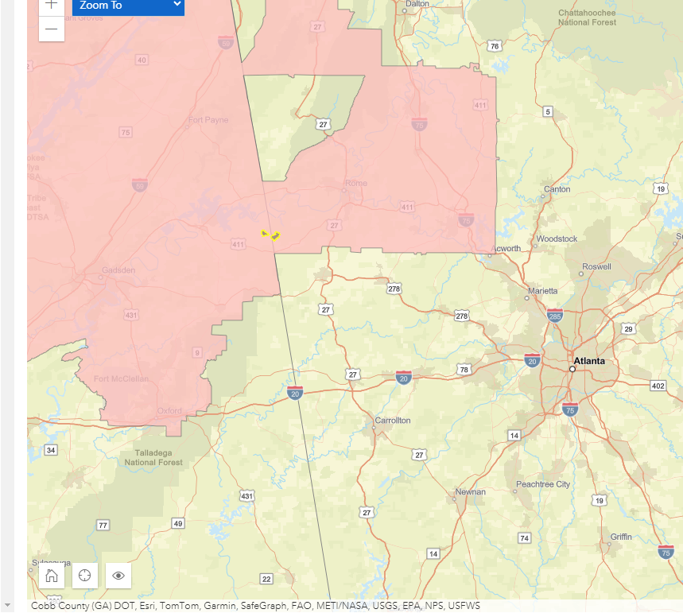
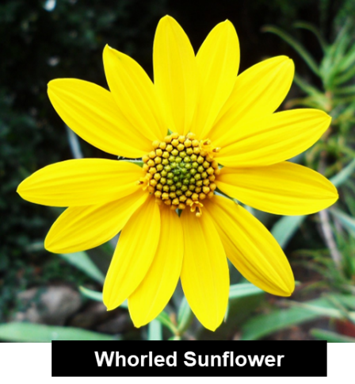

New Liberty Ultra Label - ESA Restrictions
3 points
avoidance area
Runoff
10 ft
Drift grd
BLT

Slide 14
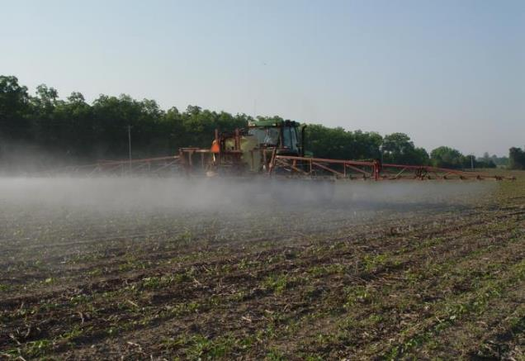

Decisions by Field – Product – Crop for Mitigations^
Particle drift
Culpepper Farm 2024, NC (small farm)
5 agronomic crops, 40 fields
30 pesticide active ingredients
372 runoff & 372 drift buffer calculations^
SC-LTF 2024, GA (dynamic farm)
26 unique vegetable & agronomic crops
16 agronomic fields,
372 vegetable “fields” (3 crops/yr)
78 pesticide active ingredients
4344 runoff & 4344 drift buffer calculations^
^Calculations are BEFORE WE GET CREATIVE using the flexibility offered by the final herbicide strategy
^Assumes insecticide/fungicide strategy follow final herbicide strategy approach.

Slide 15

Who the heck can do that on the farm?
Particle drift
Must simplify greatly…..

Slide 16
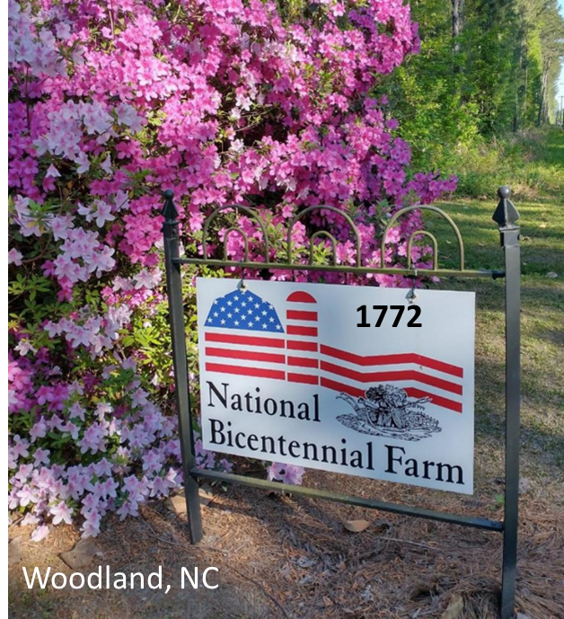
We Have Time and Can Simplify for Farmers
Advisors
Extension
Consultants
Retailers
Manufacturers
Department of Agriculture

Slide 17

Extension Approach To Overcome Herbicide Strategy!
#1
Objective 1: Get growers to 9 points for all fields overcoming runoff mitigations.
Objective 2: Help growers take 230-foot drift buffer down to near 0 (ground application).
Objective 3: Get input from growers helping us understand any barriers to meet these objectives.
#2
Particle drift

Slide 18
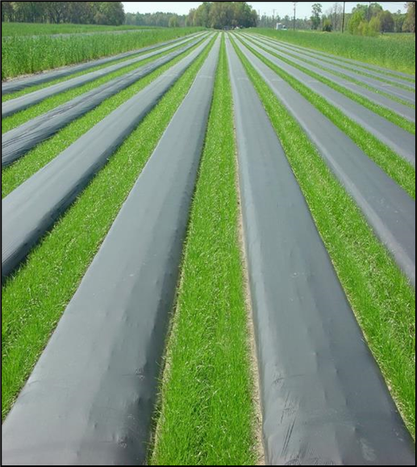
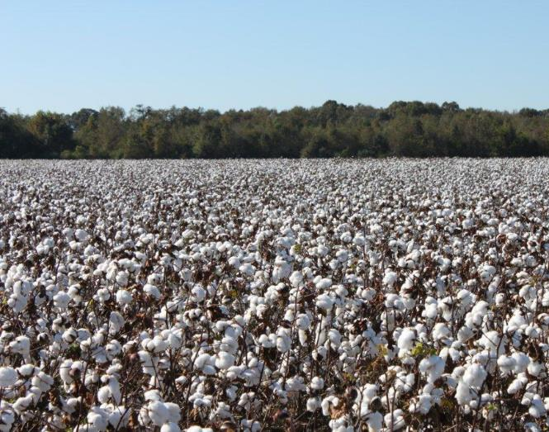
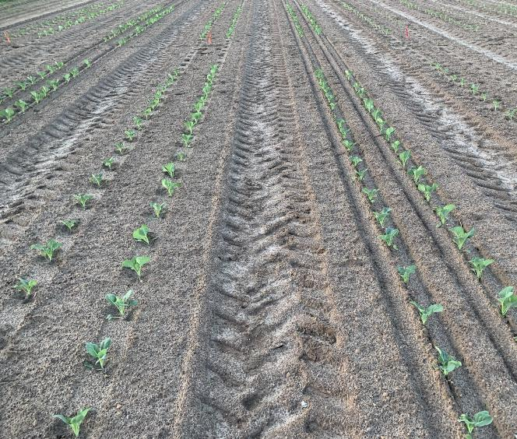
Runoff Mitigation Approach – By Production Practice
Raised Large Bed Plasticulture
Agronomic Production
Bareground – Tilled Center Pivot Veggies
For this exercise just think about one field next to the house ….after we get more comfortable, we will start thinking about other fields

Slide 19
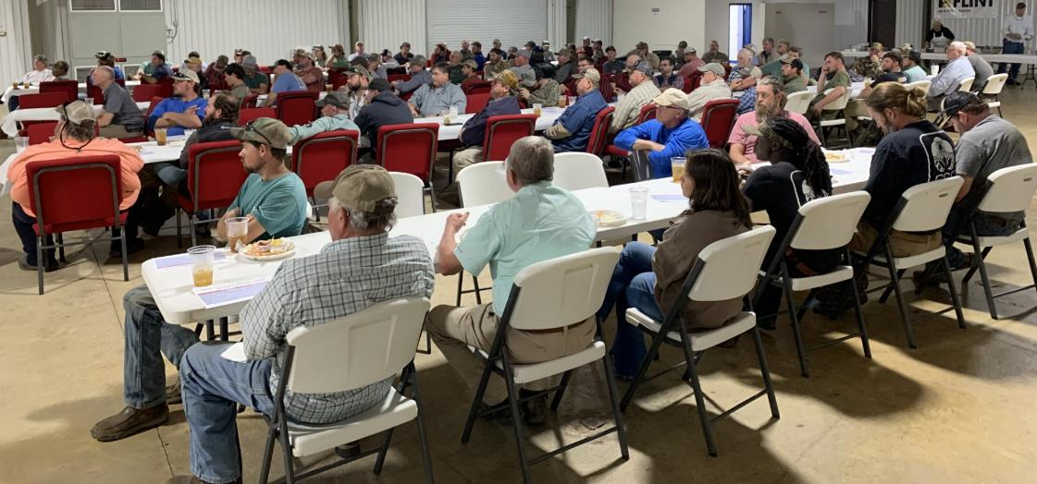
Agronomic Crop in Georgia
Mitigation | Points
Mitigation relief points
Field with < 3% slope
Sand, loamy sand or sandy loam
Cover crops
Strip-till production
Non-irrigated lands
Incorporation (center pivot or tillage)
Grass waterway
Terraces
Field border of vegetation
Mitigation tracking

Slide 20
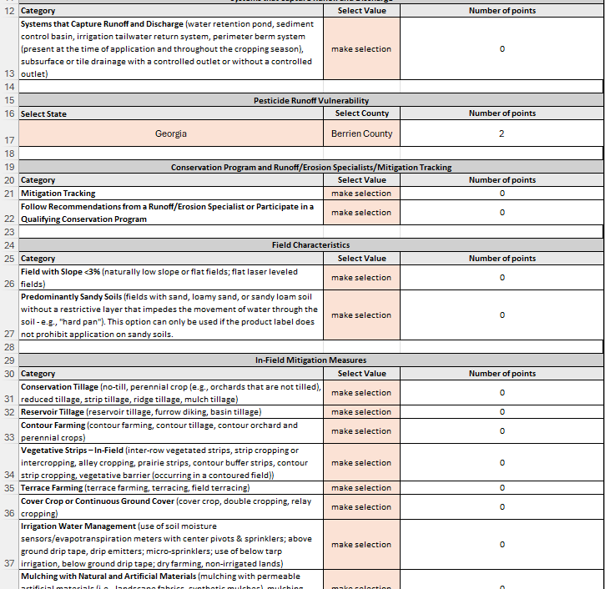
Information Available To Help = EPA Resource Toolbox?
Mitigation Menu
Mitigation Calculator Guide
Calculator is Key
Advisor……KEY
Farmer…not so much
EPA’s RUNOFF POINTS CALCULATOR
https://www.epa.gov/pesticides/mitigation-menu
https://www.epa.gov/endangered-species/pesticides-and-endangered-species-educational-resources-toolbox

Slide 21
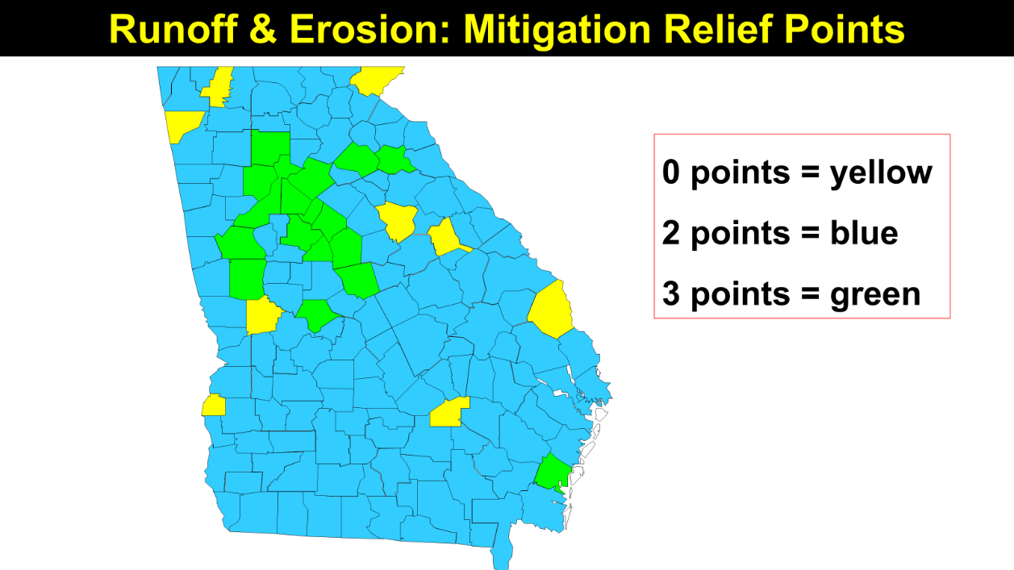
Agronomic Crop in Georgia
Mitigation | Points
Mitigation relief points | 2

Slide 22
Agronomic Crop in Georgia
Mitigation | Points
Mitigation relief points | 2
Field with < 3% slope | 2
Sand, loamy sand or sandy loam (no hard pan) | 2
Predominately Sandy Soil
50% sand, loamy sand, or sandy loam without restrictive layer that impedes movement of water into the soil
2 points

Slide 23

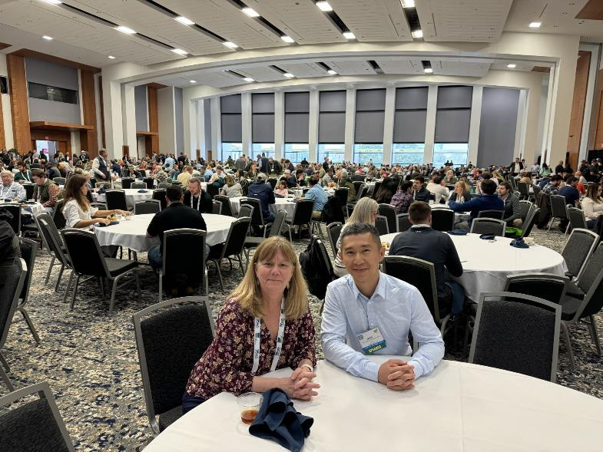
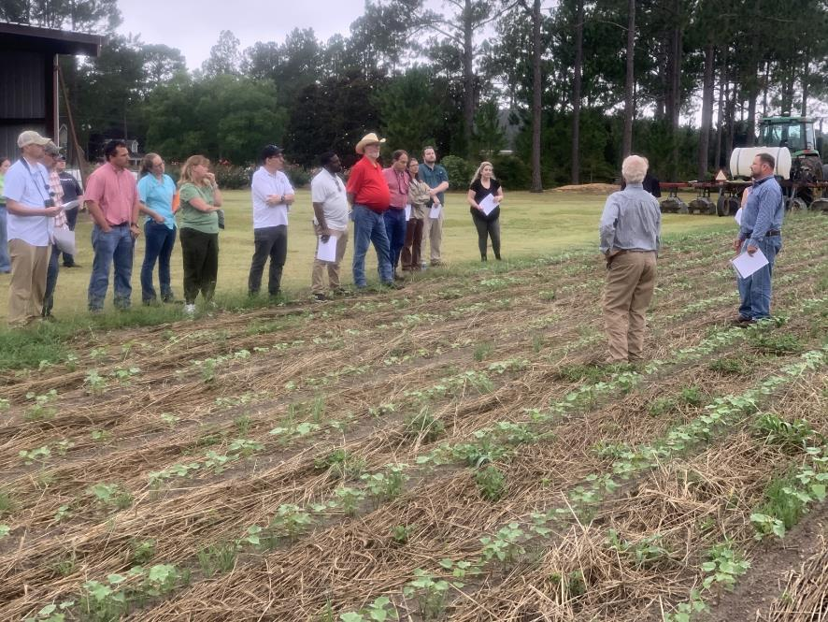
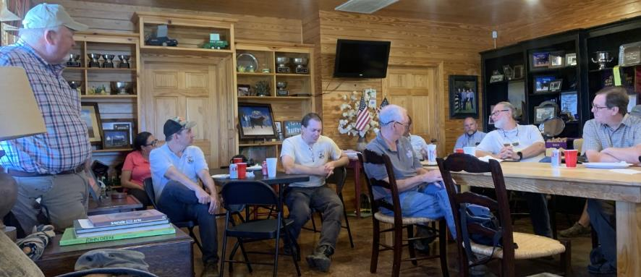
Are Our “Definitions” of Mitigations Same as the EPA’s?
Working hard to be on the same page, resources are available

Slide 24
Agronomic Crop in Georgia
Mitigation | Points
Mitigation relief points | 2
Field with < 3% slope | 2
Sand, loamy sand or sandy loam (no hard pan) | 2
Cover crops (no tillage) | 3
Cover Crop Options – Points
Tilled cover: terminated using tillage. POINTS = 1
Short duration cover: planted in fall but no active growth in spring or planted in spring. POINTS = 2
Long duration cover: planted in fall growing into spring, vegetation on field year around. POINTS = 3

Slide 25
Agronomic Crop in Georgia
Mitigation | Points
Mitigation relief points | 2
Field with < 3% slope | 2
Sand, loamy sand or sandy loam (no hard pan) | 2
Cover crops | 3
Strip-till production | 2
Non-irrigated lands | 3
Incorporation (center pivot or tillage) | 1
Grass waterway | 2
Terraces | 2
Field border of vegetation | 3
Mitigation tracking | 1
Do you have at least 9 points?

Slide 26
Other Options if Needed – Agronomic Crop
Exempt – managed areas 1000 foot down gradient
Expert (1 point) or conservation program (2 points)
3. Water sensors with center pivot = 2 points
4. Mitigation measures from multiple categories = 1 pt
Trying to avoid
Rate of product applied (annual max)
Percent of field treated (new technologies)
Trying even harder to avoid

Slide 27
Culpepper Farms: Fields 1- 36
Mitigation | Points
Mitigation relief points – Northampton County | 2
Field with less 3% slope | 2
Cover crops | 3
Strip till | 2
Dry Farming | 3
Grass waterways | 2
Multiple categories of mitigation | 1
Mitigation tracking | 1
16
As you ride around the farm this summer, think about grouping your fields and covering them on one mitigation form. Example for 36 of our fields all on one form.

Slide 28
Culpepper Farms: Fields 37-40
Mitigation | Points
Mitigation relief points – Northampton County | 2
Field with less 3% slope | 2
Cover crops | 3
Strip till | 2
Dry farming | 3
Mitigation tracking | 1
13
A few fields do not have grass waterways so when I take that away I lose multiple category mitigation as well so I am using a second form to get the last 4 fields on the farm.

Slide 29
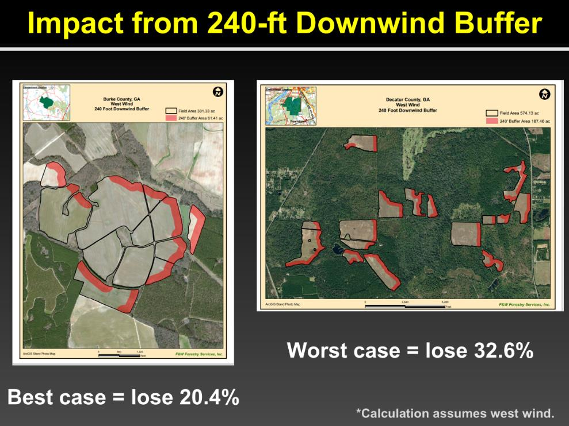

Impact From In-Field Drift Buffers*
EPA DETERMINED WORST CASE FOR GROUND RIG WILL BE 230 FEET DOWNWIND
Calculations are BEFORE WE GET CREATIVE using the flexibility offered by the final herbicide strategy
* As interpreted in the Draft Herbicide Strategy

Slide 30
Spray Drift Ground Application– (0 to 230 feet)
Mitigation Measures | % Reduction
Low boom, coarse drops | 75%
High boom, coarse drops | 65%
Low boom, fine to medium | 40%
OBJECTIVE: Take 230 feet and figure out how to make it workable on your farm
From Herbicide Strategy

Slide 31
Boom Height and Spray Droplet Size Impacts Pesticide Drift Distance (feet) to COTTON
Medium droplet
Ultra Coarse droplet
188 a
85 b
68 b
36 c
48”
24”
48”
24”
Boom Height
Boom Height

Slide 32
Spray Drift Ground Application– (0 to 230 feet)
Mitigation Measures | % Reduction
Low boom, coarse drops | 75%
High boom, coarse drops | 65%
Low boom, fine to medium | 40%
DRA as influenced by droplet | 15-30%
Relative humidity > 60% | 10%
Low boom, coarse droplets, DRA (15%), RH = 75 + 15 + 10 = 100%
From Herbicide Strategy

Slide 33
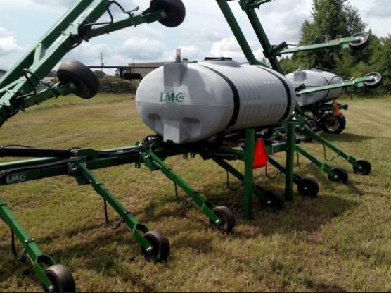
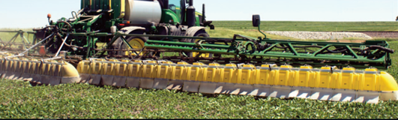
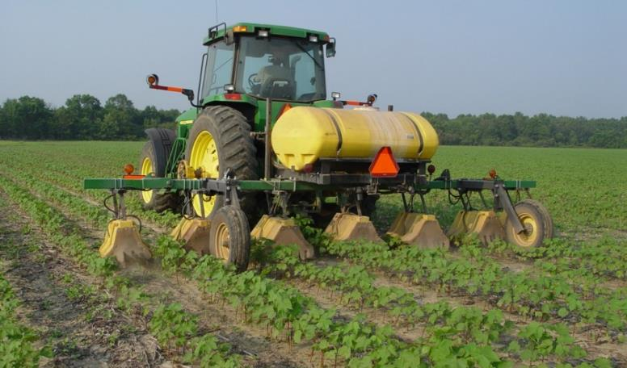
From Herbicide Strategy
Additional Methods to Reduce Buffer
Broadcast Hooded: 50%
Downwind Measures | % Reduction
Rate of product (single ap) | % below max
Windbreak – 4 foot wide, height of boom | 50%
Windbreak – 8 foot wide, 2X boom height | 75%
Forest/shrubland > 60 ft, 2X boom height | 100%
Layby Rig: 50%
Hooded: 75%

Slide 34
Managed Areas Adjacent To Treated Field Downwind Can Represent Spray Drift Buffers
Approved Out of Field Buffers Downwind - Relevant to Georgia*
Ag fields
Roads, grassy areas, bareground
Field borders, hedgerows, CRP
On-farm contained irrigation water sources (irrigation ponds)
From Herbicide Strategy
*More options are available through herbicide strategy!

Slide 35
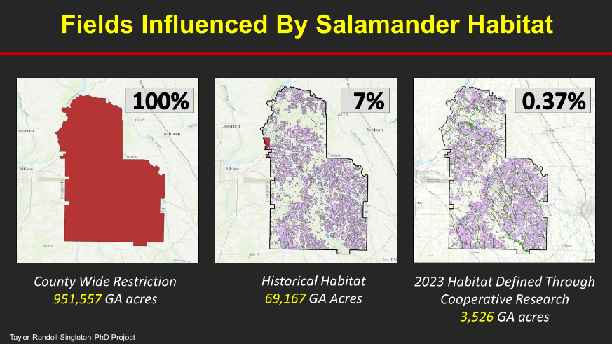
PULA Refinement
Essential to Protect Species and Farms
*
Location of species & habitat
Overlap?
Vulnerable Species Action Plan
Focus on highly vulnerable species (27)
Runoff, drift, volatility, bioaccumulation
Maps refined before restrictions
*
Location of fields treated with pesticides

Slide 36
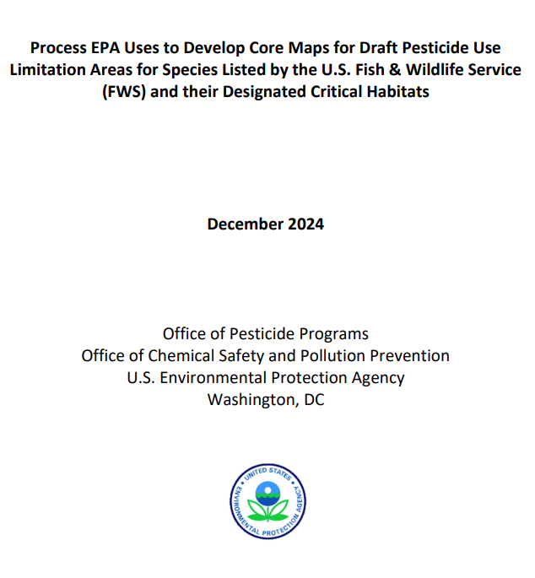
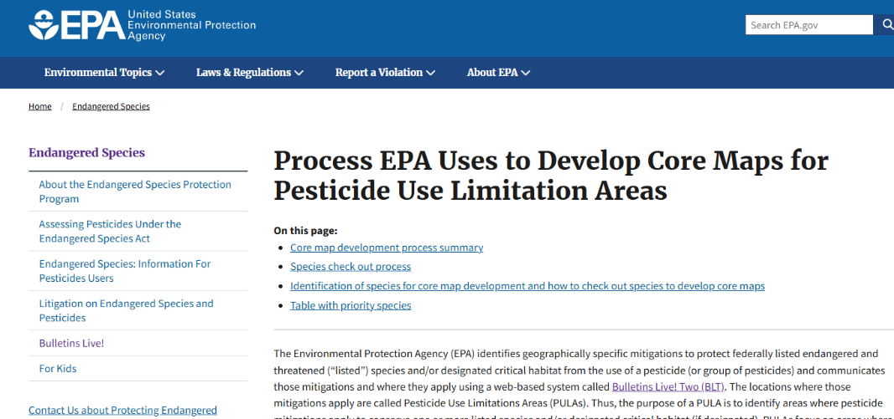
EPA Takes Mapping Approach National – Dec of 2024

Slide 37

ESA Take Home Messages
Advisors key to ESA; calculator key for advisor… calculator continues to improve
Drift calculator being developed
Help us identify issues, challenges, errors
We have time….herbicides for 2025 Liberty Ultra, Enlist One, Enlist Duo
EPA webinar in March
Remember pesticide applicators must do their part, be accountable!
1772
Notes:
Good even

Slide 38






Science, Cooperation, & Communication
Farmers
Industry Partners
Consultants

